Slide 1
Chapter 3:
Modeling Data in the Organization
Modern Database Management
8th Edition
Jeffrey A. Hoffer, Mary B. Prescott,
Fred R. McFadden

Slide 2
Objectives
Definition of terms
Importance of data modeling
Write good names and definitions for entities, relationships, and attributes
Distinguish unary, binary, and ternary relationships
Model different types of attributes, entities, relationships, and cardinalities
Draw E-R diagrams for common business situations
Convert many-to-many relationships to associative entities
Model time-dependent data using time stamps

Slide 3
Business Rules
Statements that define or constrain some aspect of the business
Assert business structure
Control/influence business behavior
Expressed in terms familiar to end users
Automated through DBMS software

Slide 4
A Good Business Rule is:
Declarative–what, not how
Precise–clear, agreed-upon meaning
Atomic–one statement
Consistent–internally and externally
Expressible–structured, natural language
Distinct–non-redundant
Business-oriented–understood by business people

Slide 5
A Good Data Name is:
Related to business, not technical, characteristics
Meaningful and self-documenting
Unique
Readable
Composed of words from an approved list
Repeatable

Slide 6
Data Definitions
Explanation of a term or fact
  Term–word or phrase with specific meaning
  Fact–association between two or more terms
Guidelines for good data definition
  Gathered in conjunction with systems requirements
  Accompanied by diagrams
  Iteratively created and refined
  Achieved by consensus

Slide 7
E-R Model Constructs
Entities:
  Entity instance–person, place, object, event, concept (often corresponds to a row in a table)
  Entity Type–collection of entities (often corresponds to a table)
Relationships:
  Relationship instance–link between entities (corresponds to primary key-foreign key equivalencies in related tables)
  Relationship type–category of relationship…link between entity types
Attribute–property or characteristic of an entity or relationship type (often corresponds to a field in a table)
Notes:
2

Slide 8
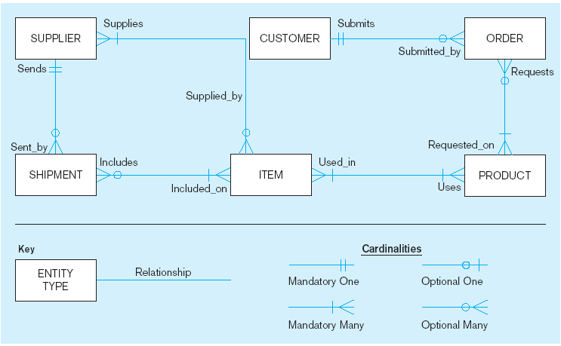
Sample E-R Diagram (Figure 3-1)
Notes:
3

Slide 9
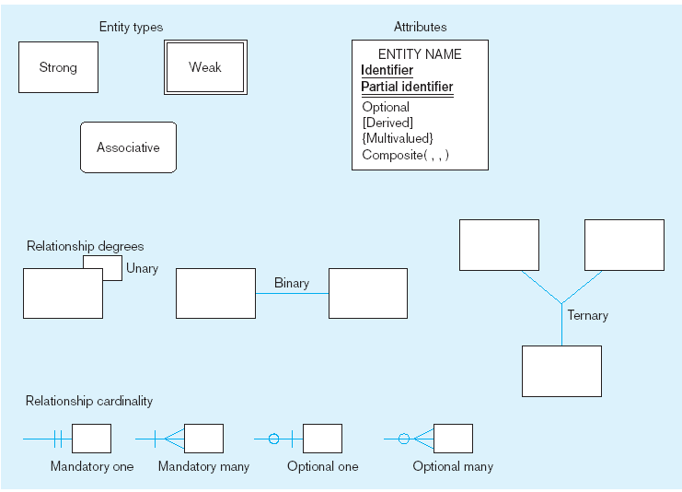
Basic E-R notation (Figure 3-2)
Entity symbols
Attribute symbols
A special entity that is also a relationship
Relationship symbols
Relationship degrees specify number of entity types involved
Relationship cardinalities specify how many of each entity type is allowed
Notes:
8

Slide 10
What Should an Entity Be?
SHOULD BE:
  An object that will have many instances in the database
  An object that will be composed of multiple attributes
  An object that we are trying to model
SHOULD NOT BE:
  A user of the database system
  An output of the database system (e.g., a report)

Slide 11
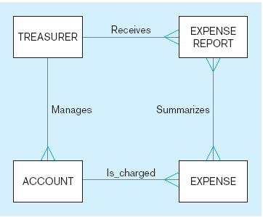
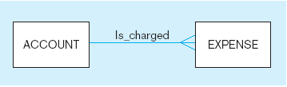
Figure 3-4 Example of inappropriate entities
System
user
System output
Inappropriate entities
Appropriate entities

Slide 12
Attributes
Attribute–property or characteristic of an entity or relationahip type
Classifications of attributes:
  Required versus Optional Attributes
  Simple versus Composite Attribute
  Single-Valued versus Multivalued Attribute
  Stored versus Derived Attributes
  Identifier Attributes
Notes:
5

Slide 13
Identifiers (Keys)
Identifier (Key)–An attribute (or combination of attributes) that uniquely identifies individual instances of an entity type
Simple versus Composite Identifier
Candidate Identifier–an attribute that could be a key…satisfies the requirements for being an identifier
Notes:
6

Slide 14
Characteristics of Identifiers
Will not change in value
Will not be null
No intelligent identifiers (e.g., containing locations or people that might change)
Substitute new, simple keys for long, composite keys
Notes:
7

Slide 15
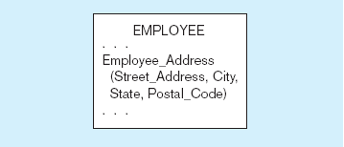
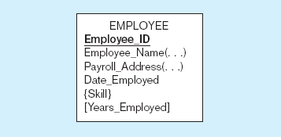
Figure 3-7 A composite attribute
An attribute broken into component parts
Figure 3-8 Entity with multivalued attribute (Skill)
and derived attribute (Years_Employed)
Multivalued
an employee can have
more than one skill
Derived
from date employed and current date
Notes:
12

Slide 16
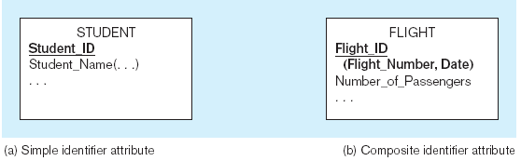
Figure 3-9 Simple and composite identifier attributes
The identifier is boldfaced and underlined
Notes:
14

Slide 17
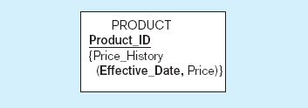
Figure 3-19 Simple example of time-stamping
This attribute that is both multivalued and composite
Notes:
37

Slide 18
More on Relationships
Relationship Types vs. Relationship Instances
  The relationship type is modeled as lines between entity types…the instance is between specific entity instances
Relationships can have attributes
  These describe features pertaining to the association between the entities in the relationship
Two entities can have more than one type of relationship between them (multiple relationships)
Associative Entity–combination of relationship and entity

Slide 19
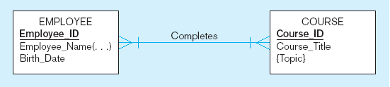
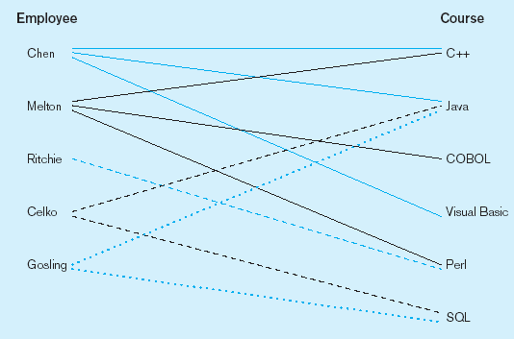
Figure 3-10 Relationship types and instances
a) Relationship type
b) Relationship instances
Notes:
17

Slide 20
Degree of Relationships
Degree of a relationship is the number of entity types that participate in it
  Unary Relationship
  Binary Relationship
  Ternary Relationship
Notes:
16

Slide 21
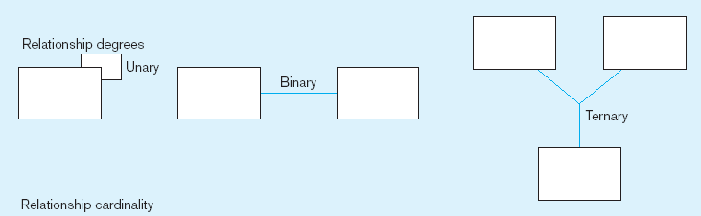
Degree of relationships – from Figure 3-2
Entities of two different types related to each other
One entity related to another of the same entity type
Entities of three different types related to each other
Notes:
8

Slide 22
Cardinality of Relationships
One-to-One
  Each entity in the relationship will have exactly one related entity
One-to-Many
  An entity on one side of the relationship can have many related entities, but an entity on the other side will have a maximum of one related entity
Many-to-Many
  Entities on both sides of the relationship can have many related entities on the other side

Slide 23
Cardinality Constraints
Cardinality Constraints - the number of instances of one entity that can or must be associated with each instance of another entity
Minimum Cardinality
  If zero, then optional
  If one or more, then mandatory
Maximum Cardinality
  The maximum number
Notes:
29

Slide 24
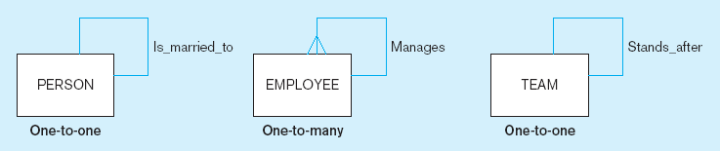
Figure 3-12 Examples of relationships of different degrees
a) Unary relationships
Notes:
22

Slide 25
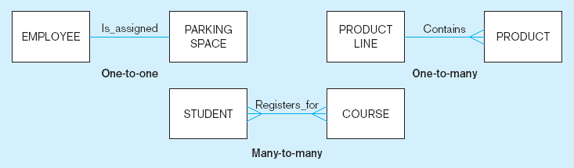
Figure 3-12 Examples of relationships of different degrees (cont.)
b) Binary relationships
Notes:
22

Slide 26
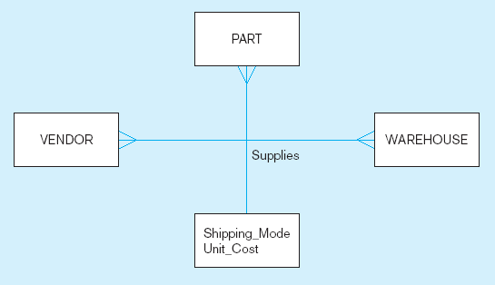
Figure 3-12 Examples of relationships of different degrees (cont.)
c) Ternary relationship
Note: a relationship can have attributes of its own
Notes:
22

Slide 27
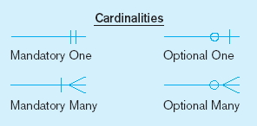
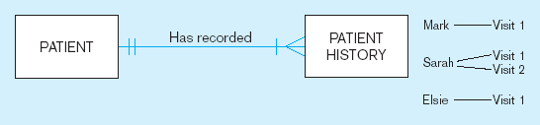
Figure 3-17 Examples of cardinality constraints
a) Mandatory cardinalities
A patient history is recorded for one and only one patient
A patient must have recorded at least one history, and can have many
Notes:
1

Slide 28
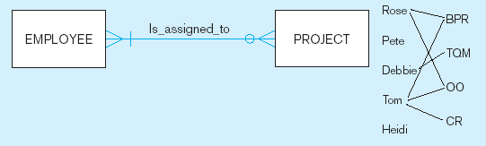
Figure 3-17 Examples of cardinality constraints (cont.)
b) One optional, one mandatory
A project must be assigned to at least one employee, and may be assigned to many
An employee can be assigned to any number of projects, or may not be assigned to any at all
Notes:
1

Slide 29
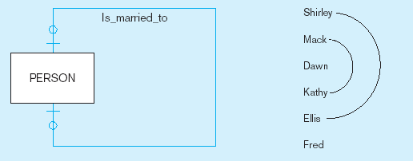
Figure 3-17 Examples of cardinality constraints (cont.)
a) Optional cardinalities
A person is is married to at most one other person, or may not be married at all
Notes:
1

Slide 30
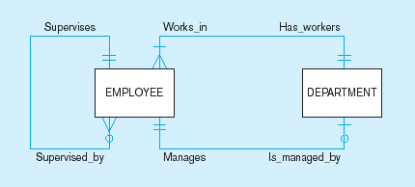
Figure 3-21 Examples of multiple relationships
a) Employees and departments
Entities can be related to one another in more than one way
Notes:
40

Slide 31
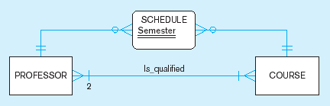
Figure 3-21 Examples of multiple relationships (cont.)
b) Professors and courses (fixed lower limit constraint)
Here, min cardinality constraint is 2
Notes:
40

Slide 32
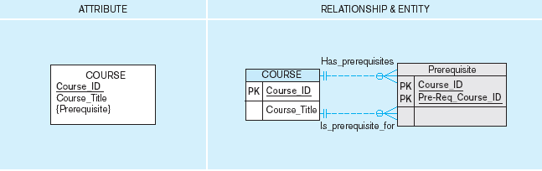
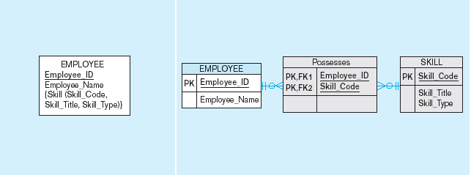
Figure 3-15a and 3-15b Multivalued attributes can be represented as relationships
simple
composite

Slide 33
Strong vs. Weak Entities, and
Identifying Relationships
Strong entities
  exist independently of other types of entities
  has its own unique identifier
  identifier underlined with single-line
Weak entity
  dependent on a strong entity (identifying owner)…cannot exist on its own
  does not have a unique identifier (only a partial identifier)
  Partial identifier underlined with double-line
  Entity box has double line
Identifying relationship
  links strong entities to weak entities

Slide 34
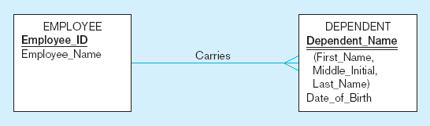
Identifying relationship
Strong entity
Weak entity

Slide 35
Associative Entities
An entity–has attributes
A relationship–links entities together
When should a relationship with attributes instead be an associative entity?
  All relationships for the associative entity should be many
  The associative entity could have meaning independent of the other entities
  The associative entity preferably has a unique identifier, and should also have other attributes
  The associative entity may participate in other relationships other than the entities of the associated relationship
  Ternary relationships should be converted to associative entities

Slide 36
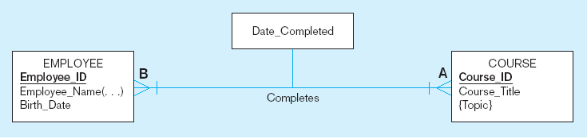
Figure 3-11a A binary relationship with an attribute
Here, the date completed attribute pertains specifically to the employee’s completion of a course…it is an attribute of the relationship
Notes:
20

Slide 37
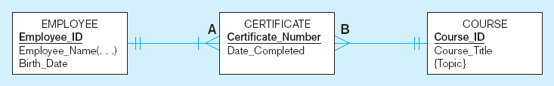
Figure 3-11b An associative entity (CERTIFICATE)
Associative entity is like a relationship with an attribute, but it is also considered to be an entity in its own right.
Note that the many-to-many cardinality between entities in Figure 3-11a has been replaced by two one-to-many relationships with the associative entity.
Notes:
21

Slide 38
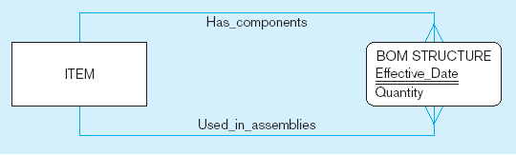
Figure 3-13c An associative entity – bill of materials structure
This could just be a relationship with attributes…it’s a judgment call
Notes:
27

Slide 39
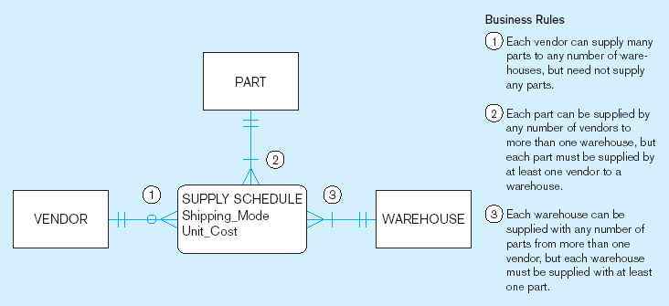
Figure 3-18 Ternary relationship as an associative entity
Notes:
36

Slide 40
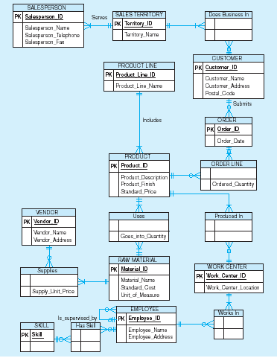
Microsoft Visio Notation for Pine Valley Furniture
E-R diagram
Different modeling software tools may have different notation for the same constructs

